Slide 1
SCARE-CROW
ROLLNUMBER | NAME
21881A05E8 | VAMSHI
21881A05E9 | AKHIL
21881A05F0 | NIKITHA
21881A05F4 | VIVEK
21881A05F6 | BHANU
21881A05F7 | SAI SATHWIK
TEAM -6
21881A05E8 - VAMSHI
21881A05E9 - AKHIL
21881A05F0 - NIKITHA
21881A05F4 - VIVEK
21881A05F6 - BHANU
21881A05F7 - SAI SATHWIK

Slide 2
Outline of the Presentation
Introduction
Objective
Project description
Schematic Model
Working of project
Components
Applications
Conclusions
References

Slide 3
Introduction
As we can observe, cities are filled with many birds especially pigeons
These birds create a lot of problem, like their dump everywhere and the sounds etc.…
Also we know that the feathers of birds and dust generated by the birds is harmful for people having asthma or any other breathing problems.
For that, people have scare them away every time they sit near the windows or on pipes which is very problematic
So we are trying to avoid this problem for the people that is by scaring the birds away using IoT.

Slide 4
Objective
Our project’s main objective is to avoid the problems by the birds in cities.
Our projects acts like a scare-crow by generating sound on the user’s command

Slide 5
Project Description
1.It uses an ultrasonic module interfaced to a microcontroller.
2.The ultrasonic sensor is consists of Transmitter and Receiver modules.
3.Transmitter part ejects the pulse out and the receiver part receives the pulse.
4.If a bird comes in front of the sensor , the transmitted pulse ejected strike the bird and reflected back. The reflected pulse is received by the receiver part.

Slide 6
5. It measures the distance of the object placed before it .
6. The degree of the rotation of the motor is directly proportional to
to the distance of the object from ultrasonic module.
7. This can be further calibrated to calculate the actual distance of
the object from the module.
8. Then the object which is detected will let be taken as the input to , turn on the buzzer.

Slide 7
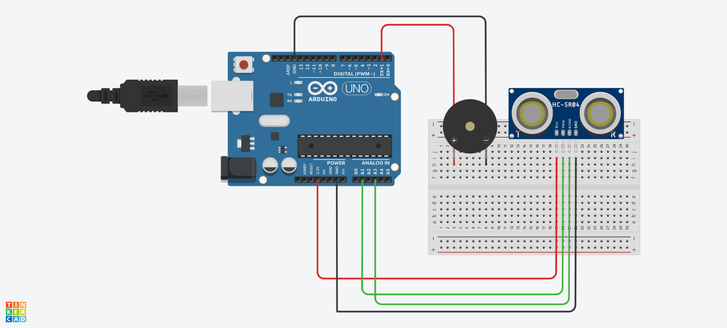
Schematic Model

Slide 8
Components
Microcontroller
Micro servo 9g
Arduino uno
Connecting wires
Breadboard
Resistors
Capacitors
Ultrasonic sensor

Slide 9
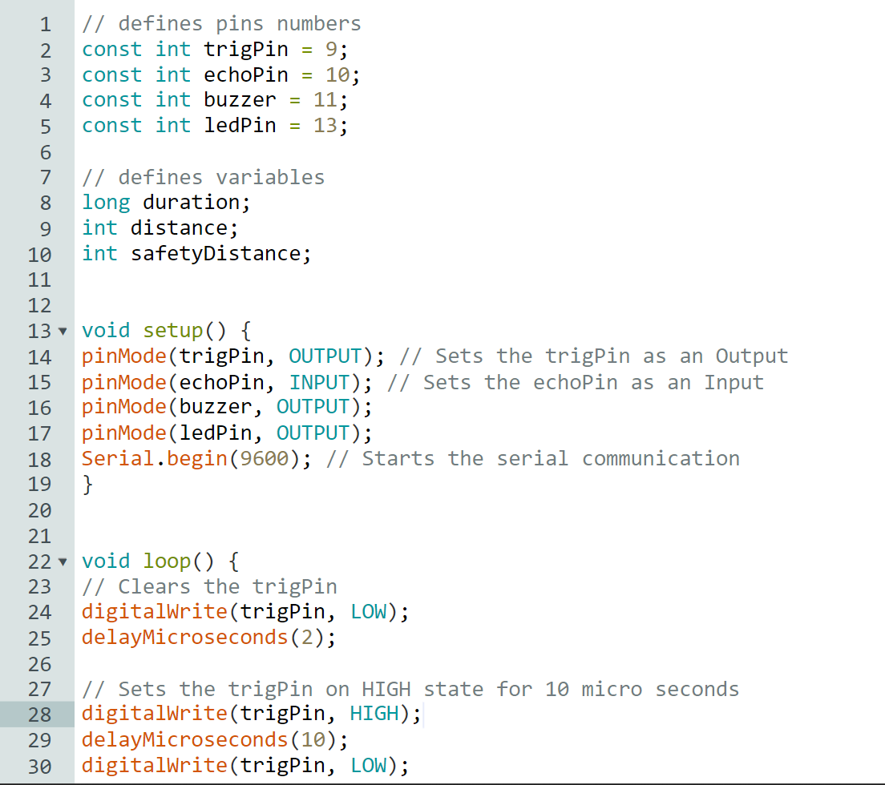
Source Code

Slide 10
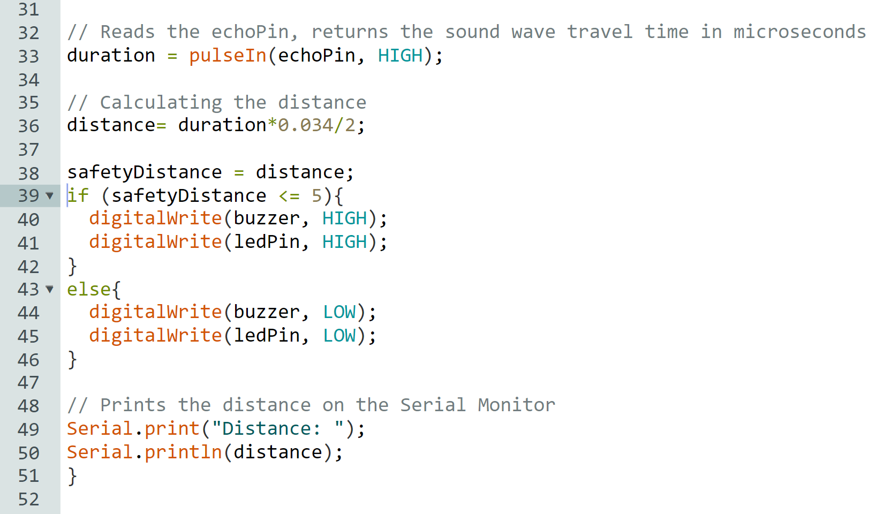

Slide 11
Working of Project
The basic principle of ultrasonic distance measurement is based on ECHO.
When the sound waves are transmitted in the environment then waves are returned back to the origin as ECHO after striking on the obstacle.
So we only need to calculate the traveling time of both sounds means outgoing time and returning time to origin after striking on the obstacle.
The distance measurement which is seen on LCD displays the distance in cms.

Slide 12
The high-level signal is sent to 10 microseconds using Trigger.
The module sends 40 KHz signals automatically and then detects whether the pulse is received or not through ECHO.
If the signal is received ,then it is through the high level. The time of high duration is the time gap between sending and receiving the signal is calculated

Slide 13
The average height of the bird is about 25-30 cm above the surface. So, the sensor is placed according to that .
So, when the bird comes into range the buzzer will be activated and will provoke the bird and hence the bird flies away.

Slide 14
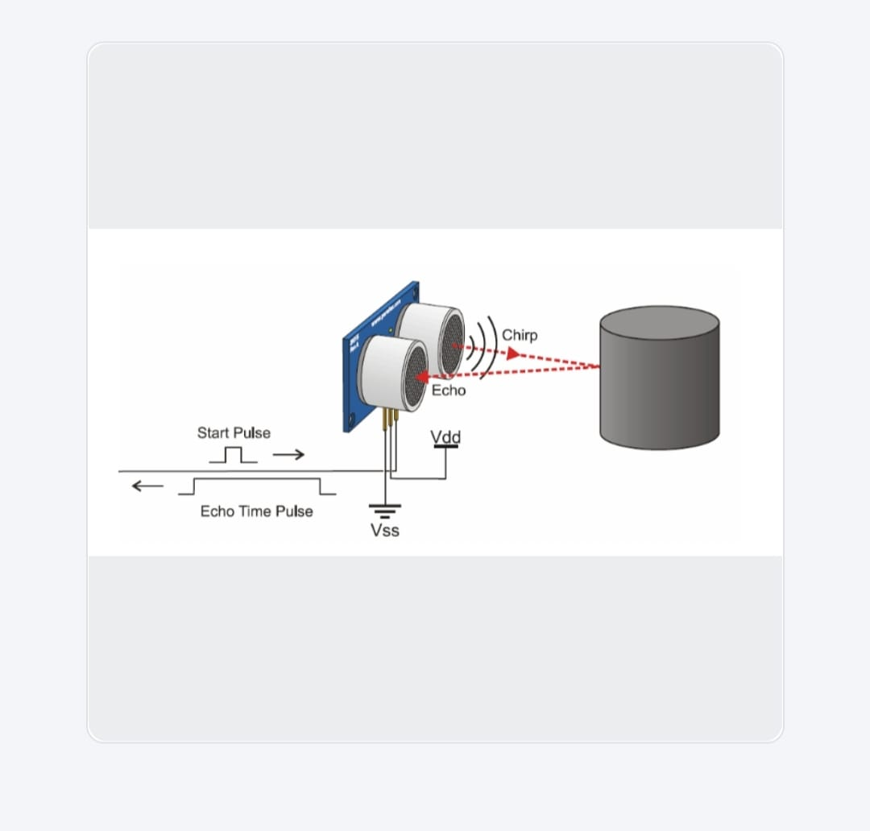

Slide 15


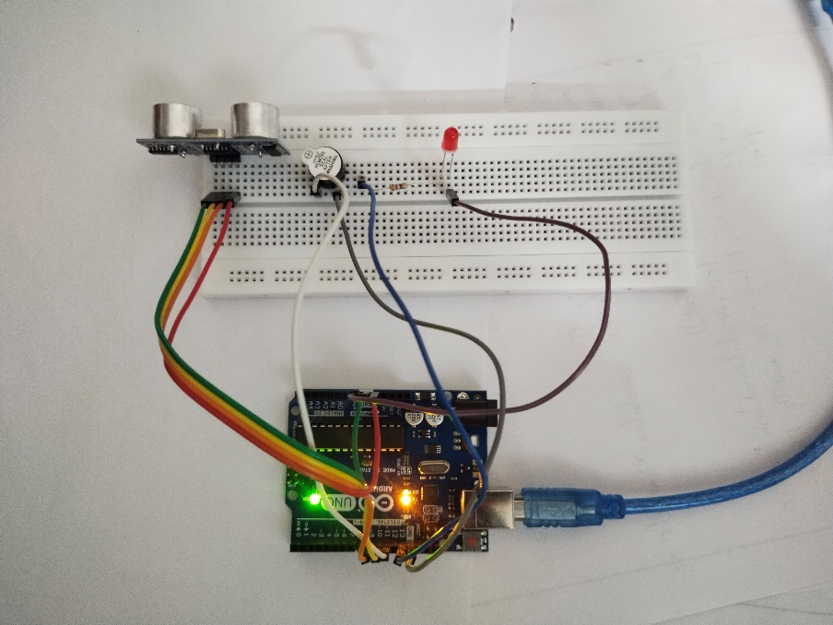
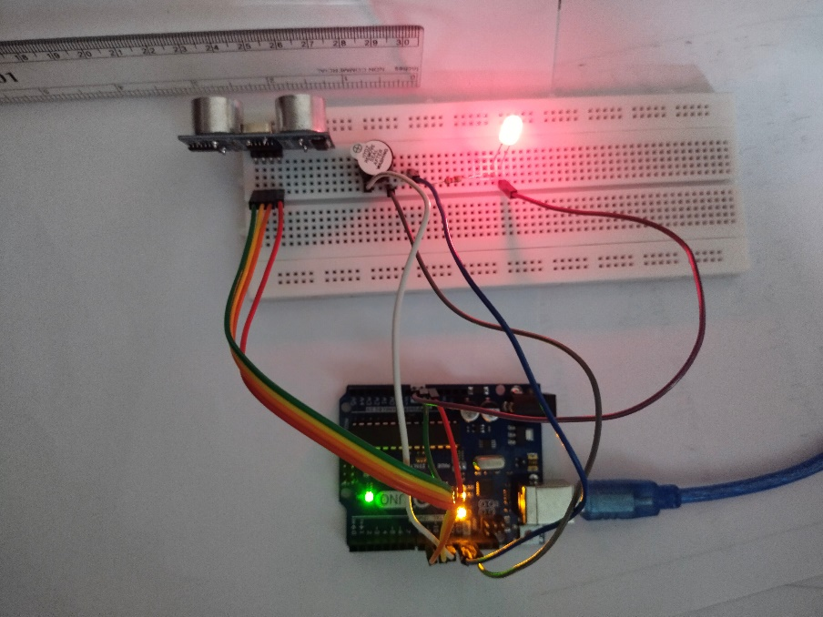
Working Model

Slide 16
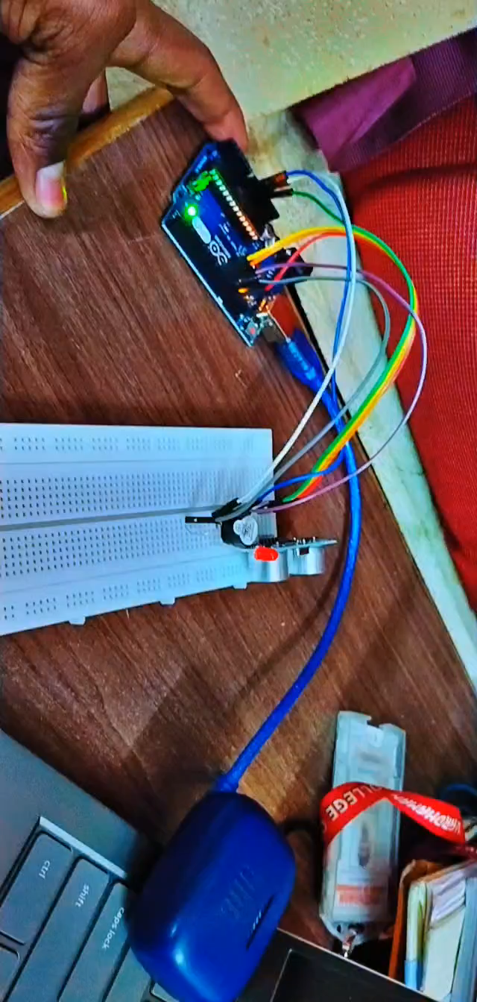

Slide 17
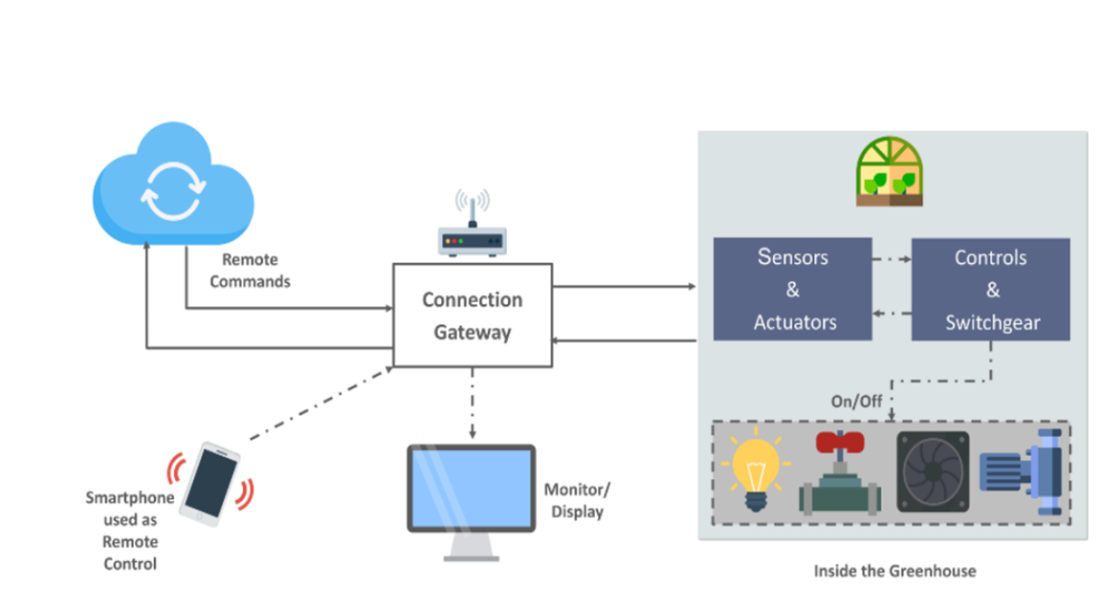
Future Plans On Project
In future we are going to add a camera option so that the user can explicitly turn on the buzzer looking at the camera to avoid unnecessary disturbances.

Slide 18
Various Disciplines Involved
COMPUTER SCIENCE ENGINEERING: To run program in microcontroller.
ELECTRICAL ENGINEERING: To develop internal circuits.
MECHANICAL ENGINEER: It helps in designing and developing the tools of the system.

Slide 19
Applications
Used to scare the birds.
Avoids disturbances caused by the birds.
Hygiene and cleanliness can be maintained.
People who suffer with breathing problems may no longer have problems because of birds feathers and dust by it.

Slide 20
Conclusions
This prototype is to check the bird without any physical reference.
Ultrasonic sensors can measure the distance to a wide range of objects regardless of shape, color or surface texture.
They are also able to measure an approaching or receding object. By using “non-contact” ultrasonic sensors , distances can be measured without damage to the bird.
The ultrasonic sensor emits a high-frequency sound pulse and calculates the distance.

Slide 21
References
https://WWW.erpublication.org/published_paper/IJ
https://WWW.fierceelectronics .com/sensors/what-ultrasonic-sensor
https://docs.ardunio.cc/hardware/uno-rev3

Slide 22
THANK YOU....

